Slide 1
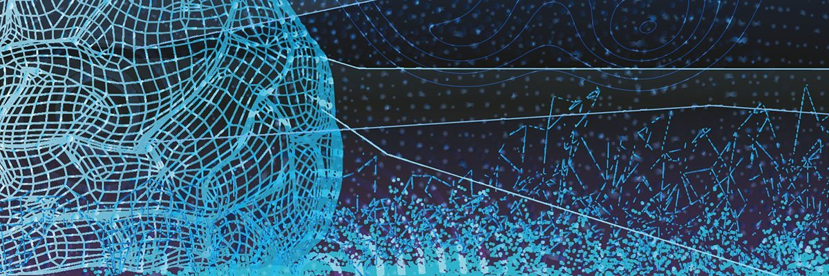



Deep Learning in Medicine
Eleftherios Trivizakis
PhD candidate
Notes:
- I do not represent any of these institutes

Slide 2


Shameless plug
BSc & MSc, Hellenic Mediterranean University
PhD candidate, University of Crete
Member, Computational BioMedical Laboratory
Published in: IEEE Journal of Biomedical & Health Informatics, Oncology Reports, IEEE Affective Computing & Intelligent Interaction
Trivizakis – DL in Medicine

Slide 3
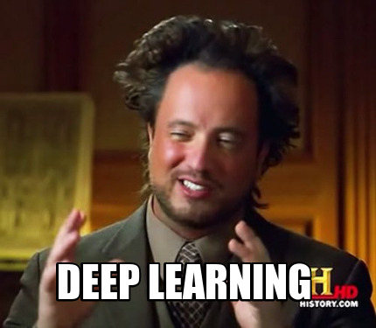
Sneak peek
AI & DL stuff
DL in medicine
Design a DL model
DL research in 5 steps
Live research demo
Trivizakis – DL in Medicine
Notes:
-intuitive DL
-(bold statement;) teach them how-to be d.s. in 5 steps ;)

Slide 4
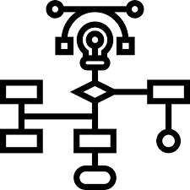
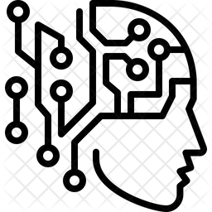
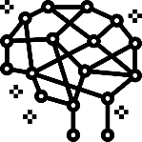
Artificial Intelligence
GOFAI
rule-based AI:
propositional & symbolic logic
program + knowledge base = intelligence
part-human & part-machine:
human feature extraction
automatic inference
Machine Learning
Deep
Learning
brain-inspired:
100% data-driven
fully-automated
end-to-end inference
Trivizakis – DL in Medicine
Notes:
Evolution of AI
-gofai: models the problem, program optimized by its knowledge base
-machine learning not explicity programed: svm, random forests, simple ann
-deep learning: cnn, rnn, hybrid cnn with rnn layers, capsulenets

Slide 5
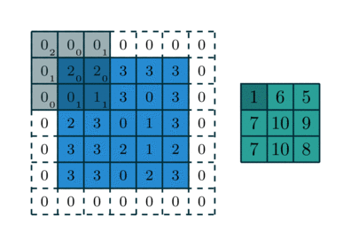
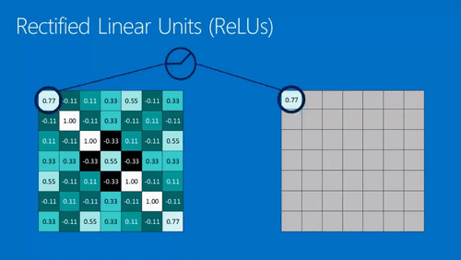

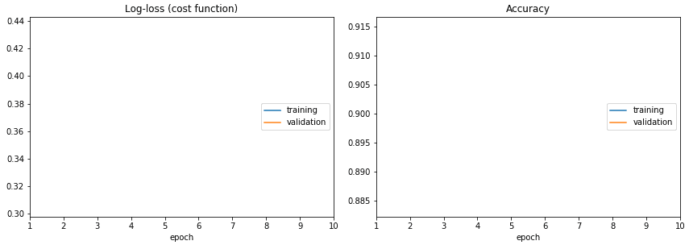
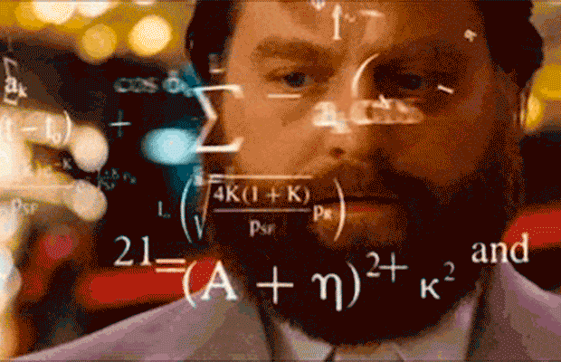
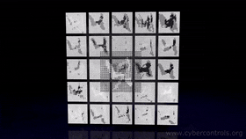
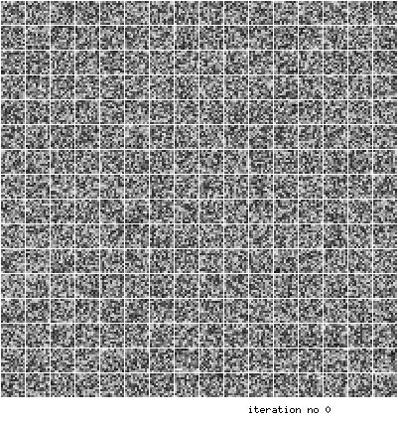
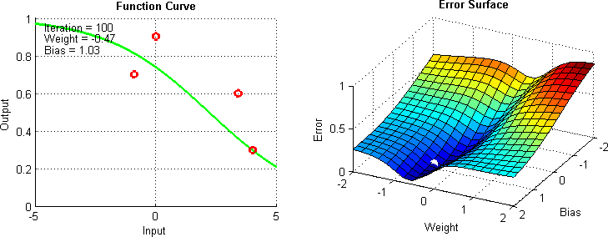
Some Boring Stuff
The “Jesus” of DL
Learning Curves
CNN in action!
Optimization
Trivizakis – DL in Medicine
Notes:
-CNN layer: convolution & Relu
-kernel convolves over image
-feature maps
-ReLu fires when positive values
-noise information reduction
-feature maps in action
-models are complex
-10s of millions of learned parameters
-learning curves to find the best model from inf. Models
-compare training acc vs validation acc
-I won’t get into details about model convergence, weight optimization
-AI learns like human: trial & error

Slide 6
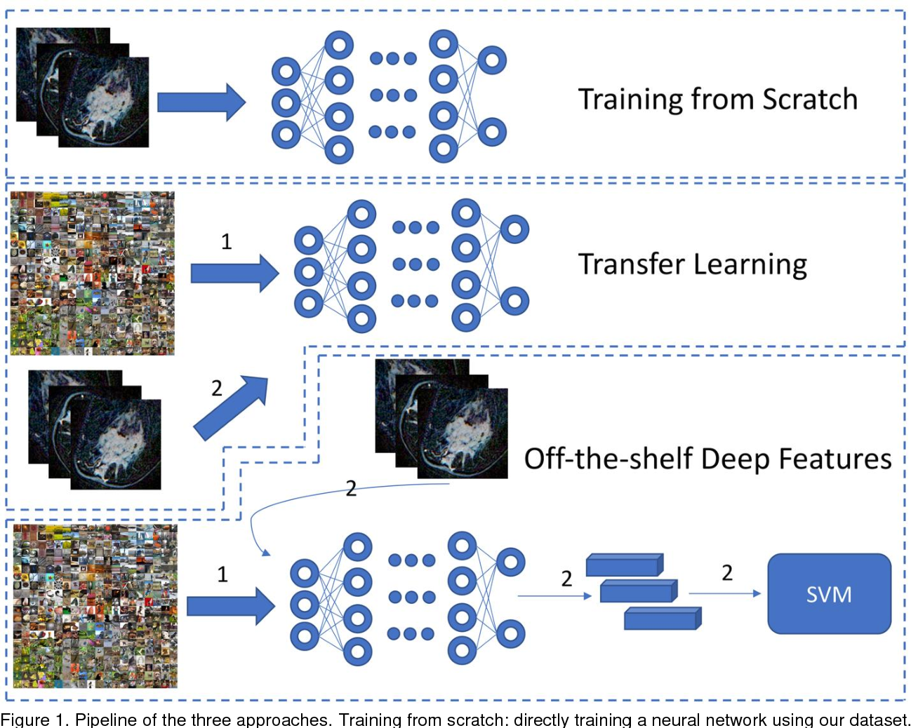
Transfer learning
Even faster inference
“off-the-shelf”
fine-tuned
Repurpose models
Avoid tedious model fitting & hypes opt
Ideal for small medical datasets
1. Zhu, Zhe, et al. "Deep Learning for identifying radiogenomic associations in breast cancer." Computers in biology and medicine 109 (2019): 85-90.
Trivizakis – DL in Medicine
Notes:
-easy solution
-pre-trained model on imagenet
-use in other domains besides natural images
-fine-tune == best results
-repurpose for other imaging tasks like semantic segmentation
-open databases can be used accordingly
-ideal in medicine

Slide 7
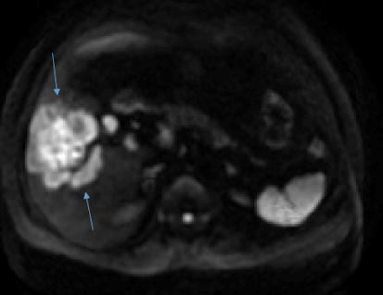
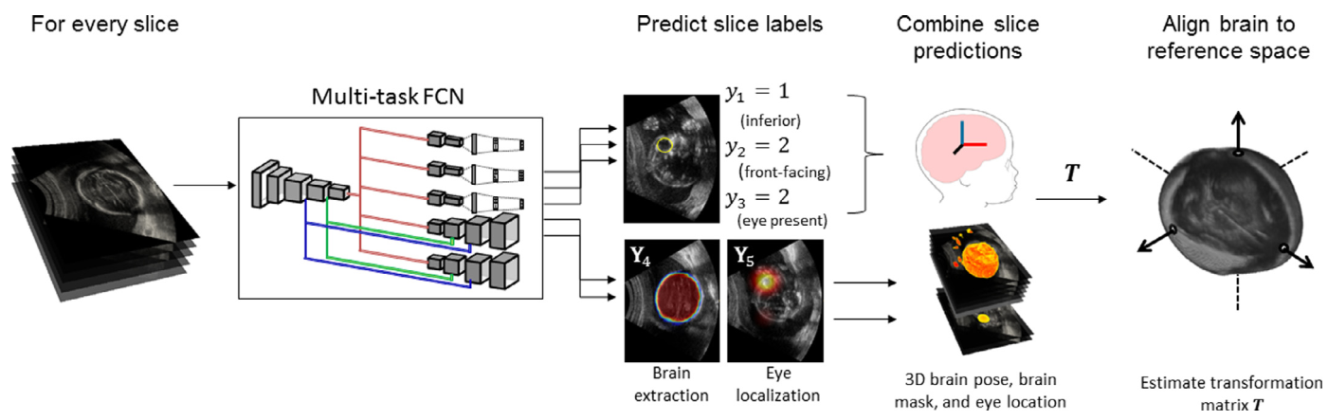
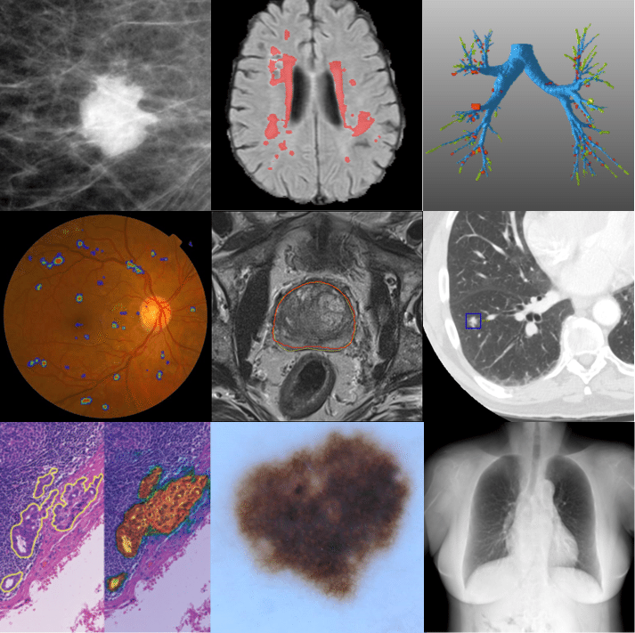
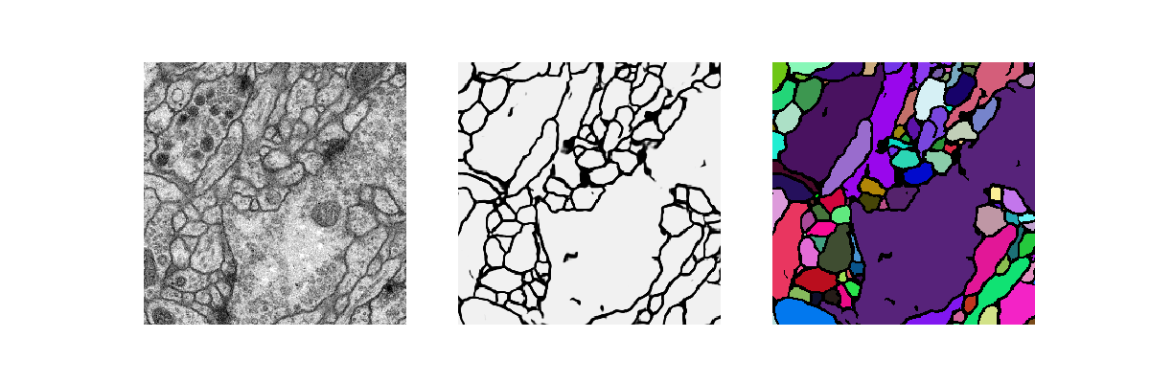
Medical Imaging
Modalities
Magnetic Resonance Imaging
Computer Tomography
Ultra sound
Optical coherence tomography
Applied on
Liver cancer
Breast density
Brain gliomas
Lesion detection
Organ localization
Fetal brain registration
Better than human experts
1.
2.
3.
4.
Trivizakis, E., et al. "Extending 2-D Convolutional Neural Networks to 3-D for Advancing Deep Learning Cancer Classification With Application to MRI Liver Tumor Differentiation." IEEE journal of biomedical and health informatics 23.3 (2018): 923-930.
Namburete, A ., et al. "Fully-automated alignment of 3D fetal brain ultrasound to a canonical reference space using multi-task learning," Medical image analysis (2018), vol. 46, pp. 1-14,
Litjens, Geert, et al. "A survey on deep learning in medical image analysis." Medical image analysis 42 (2017): 60-88.
Ronneberger , et al. "U-net: Convolutional networks for biomedical image segmentation." International Conference on Medical image computing and computer-assisted intervention. (2015) Springer, Cham.
Trivizakis – DL in Medicine
Notes:
-Medim plays a significant role in diagnosis
-developed imaging modality for different lesions
-goal of DL: fully-automated diagnosis from images

Slide 8
Radiogenomics
Combine genomic data with imaging features
Image to genomics
Improved diagnosis accuracy
Trivizakis – DL in Medicine
Notes:
-fast emerging field

Slide 9
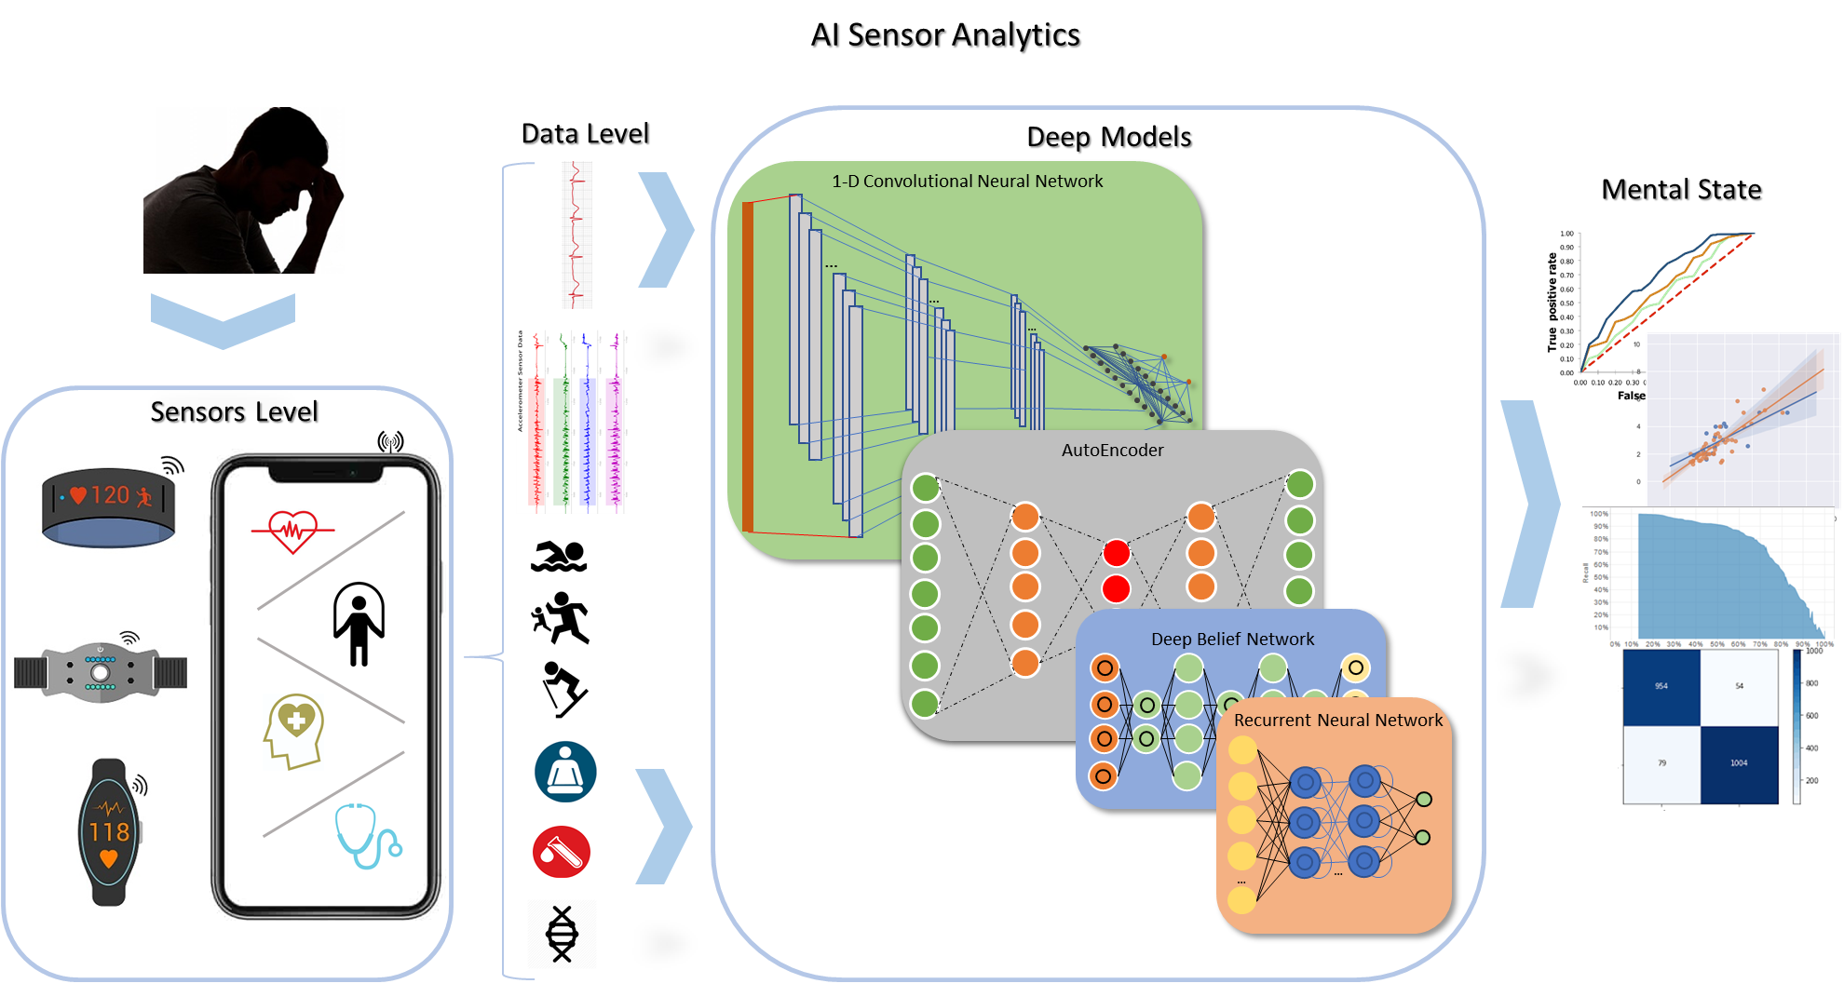
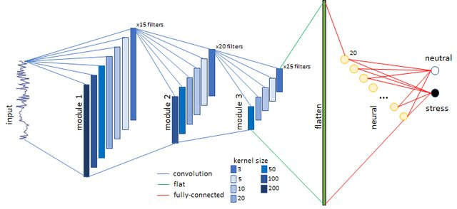
Biosignals
Applied on
ECG
EEG
Accelerometer
Gyroscope
Detects
Brain disorders
Stress
Activity
Motion
State-of-the-art performance
Giannakakis G., Trivizakis E., Tsiknakis M, and Marias K., 2019. A novel multi-kernel 1D convolutional neural network for stress recognition from ECG. Eighth International Conference on Affective Computing and Intelligence Interaction (ACII), In press: IEEE Xplore
Trivizakis – DL in Medicine
Notes:
-hot topic in medicine
-smart devices
-sensors
-mental state of a patient is important
-DL outperforms traditional methods in stress recognition

Slide 10
And now the fun part!

Slide 11

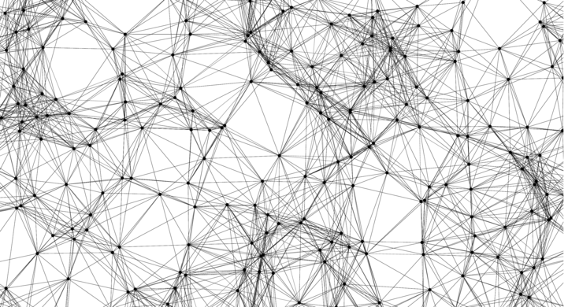


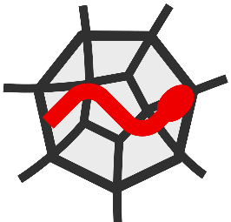
How to make a DL model?
Tools
Design
Model
Data
Architecture
Fitting
Trivizakis – DL in Medicine
Notes:
-select libraries
-process data
-choose architecture
-apply a fitting strategy

Slide 12
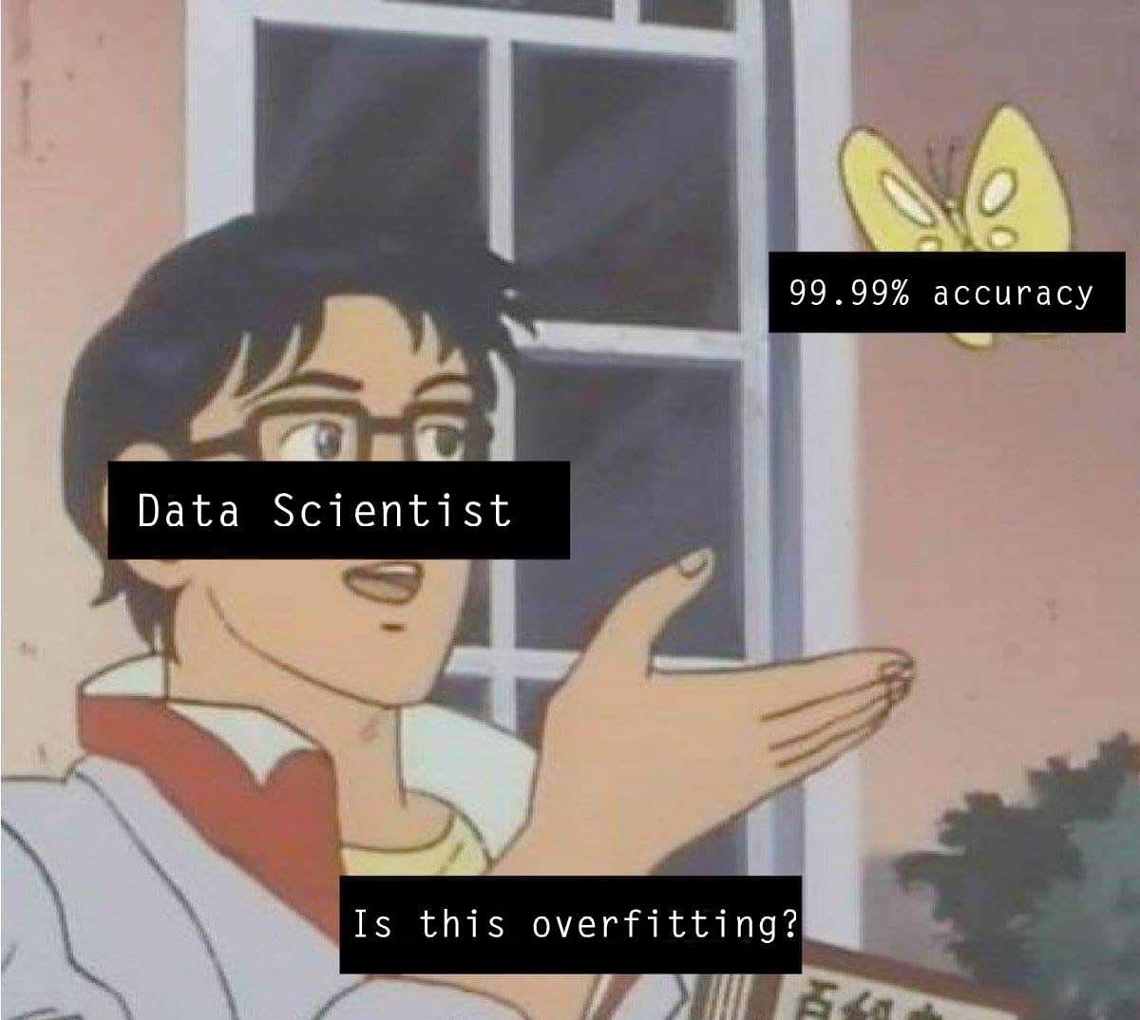
How to evaluate your methodology?
Trivizakis – DL in Medicine
Notes:
- Millions of learnt parameters

Slide 13
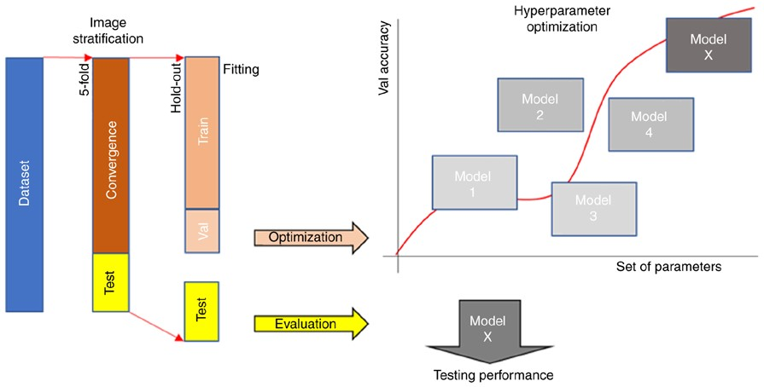
How to evaluate your methodology?
Trivizakis – DL in Medicine
Notes:
-iterative analysis with many testing sets
-validation set: hypes opt, model selection and early-stopping

Slide 14

How to optimize hypes?
Trivizakis – DL in Medicine
Notes:
-difficult due to:
not intuitive
many hypes
computational time for just one hypes setting

Slide 15
Transfer learning (how-to)
Keras repo download a pre-trained model
Transfer to your target model the weights
Fine-tuning (optional)
Apply DL to your data
1. Trivizakis, E., et al. "A novel deep learning architecture outperforming ‘off‑the‑shelf’ transfer learning and feature‑based methods in the automated assessment of mammographic breast density.“, Oncology Reports (2019).
Trivizakis – DL in Medicine
Notes:
- Avoid hypes opt & data stratification of small datasets
- off-the-shelf outperforms traditional feature extraction algorithm

Slide 16
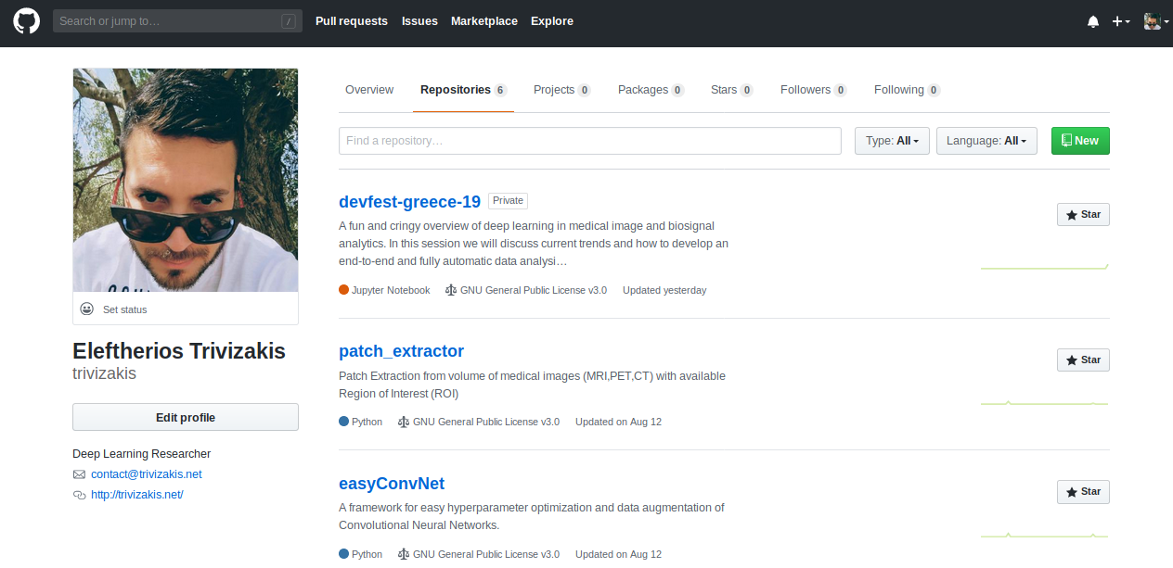
Data scientist in 5 steps!
Go to my github
Clone “EasyConvNet”
Provide the data handler
Tweak “hypes” file
Execute the script

Slide 17
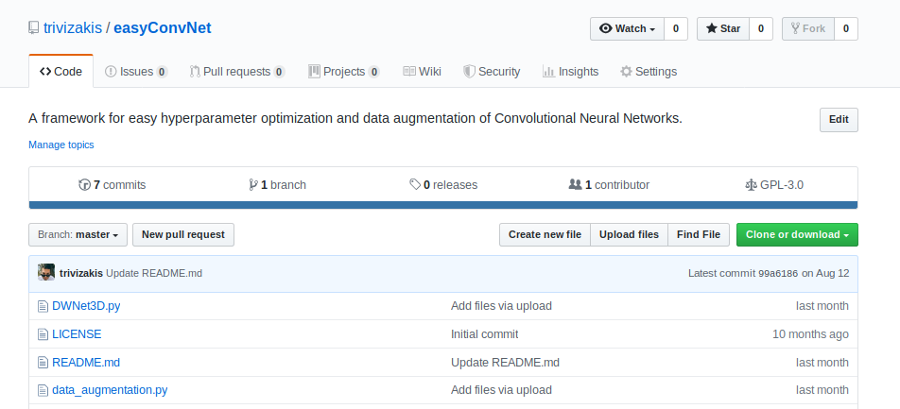
Data scientist in 5 steps!
Go to my github
Clone “EasyConvNet”
Provide the data handler
Tweak “hypes” file
Execute the script

Slide 18
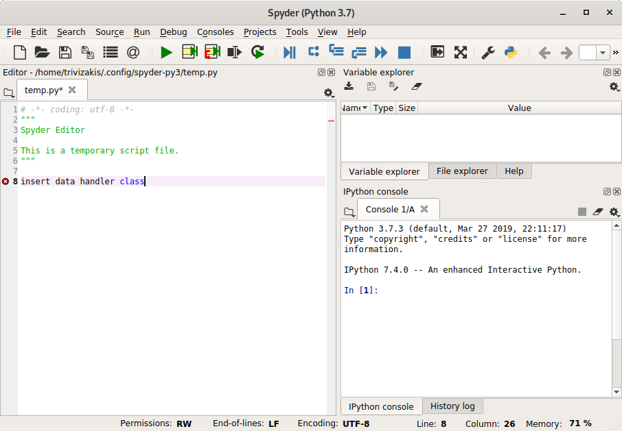
Data scientist in 5 steps!
Go to my github
Clone “EasyConvNet”
Provide the data handler
Tweak “hypes” file
Execute the script

Slide 19
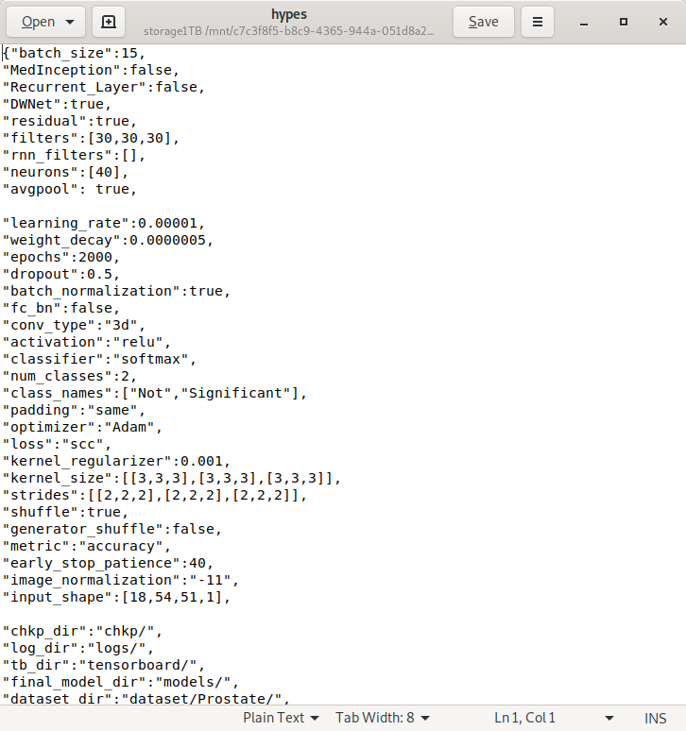
Data scientist in 5 steps!
Go to my github
Clone “EasyConvNet”
Provide the data handler
Tweak “hypes” file
Execute the script

Slide 20
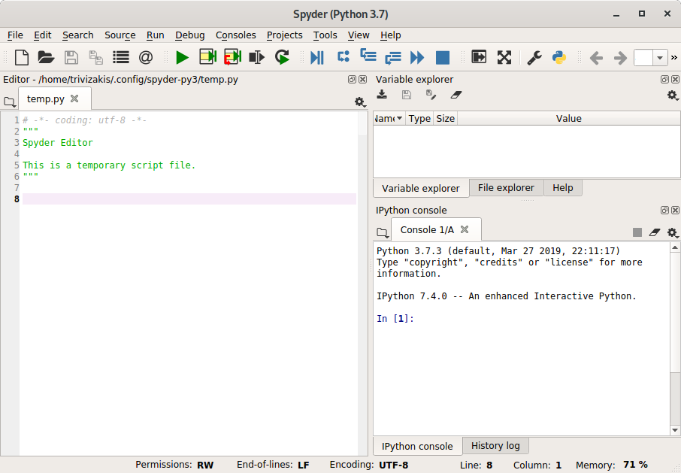
Data scientist in 5 steps!
Go to my github
Clone “EasyConvNet”
Provide the data handler
Tweak “hypes” file
Execute the script

Slide 21
Not done yet! Let’s code now!
Please inflate my ego by following me on social media ;)
source code available at: github.com/trivizakis/
publications: researchgate.net/profile/Eleftherios_Trivizakis
endorsements: linkedin.com/in/eleftheriostrivizakis
gscholar profile: Eleftherios Trivizakis
website: http://trivizakis.net
Trivizakis – DL in Medicine
Notes:
Source code and keynote in github

